Slide 1
LAB - MNIST CLASSIFICATION

Slide 2


IMPORT fetch_openml and load MNIST dataset
Output:

Slide 3


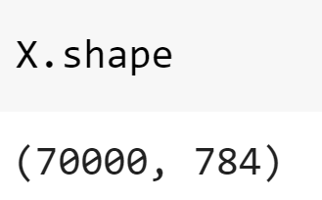

Slide 4

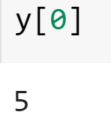

Slide 5
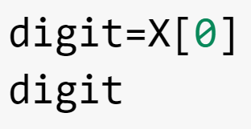
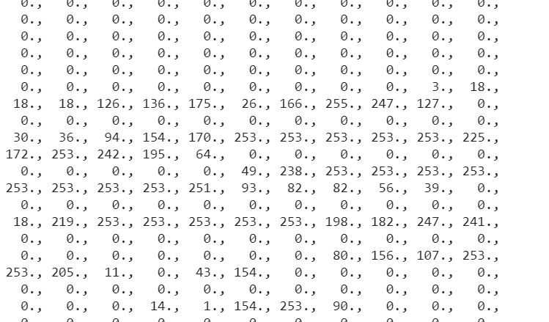
It’s a numpy array

Slide 6


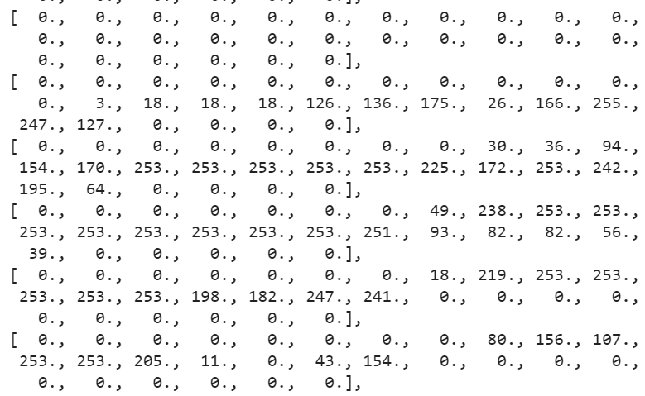

Slide 7


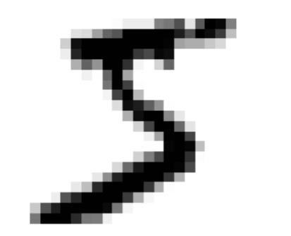

Slide 8


# produces the random permutation of shuffle. Some learning algorithms are sensitive to the order of the training instances, and they perform poorly if
#they get many similar instances in a row.
Shuffling the dataset ensures that this won’t happen

Slide 9



#variable sgd_clf is initialised Classifier object, include the maximum iteration and provide the tolerance value

Slide 10


Slide 11



Slide 12
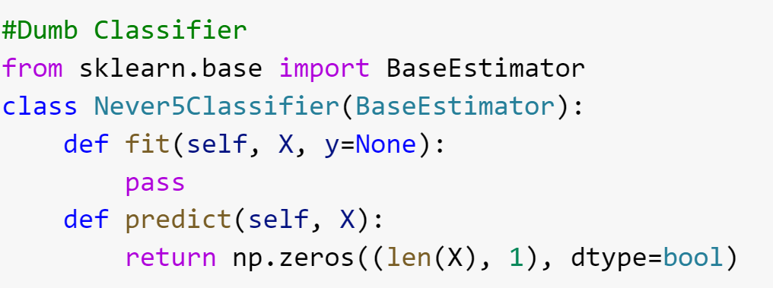


Slide 13
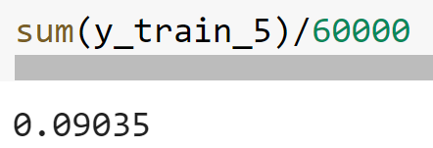

Slide 14



Slide 15
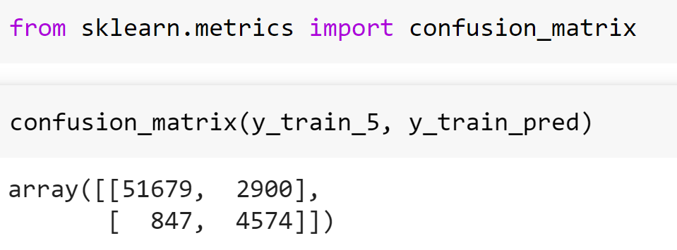

Slide 16




Slide 17
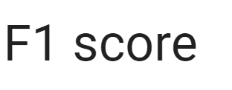



Slide 18




Slide 19




Slide 20
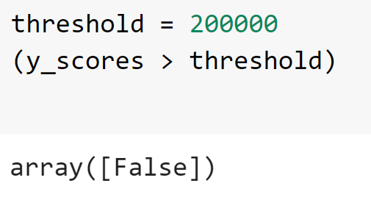


Slide 21


